Slide 1
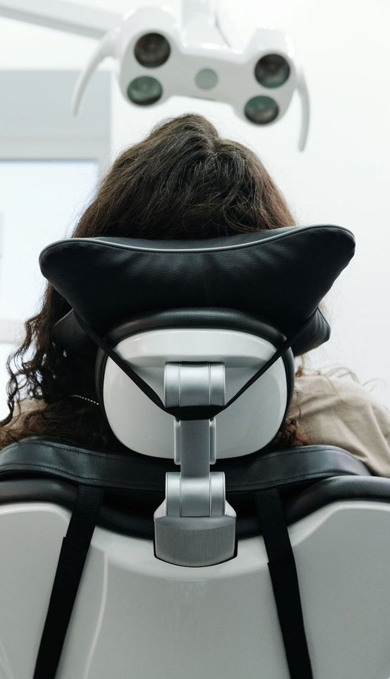

ADVERTISER PACK
2026 / 27
Reach the people
who buy.
For the people who own, run, buy and finance UK dental practices.
DENTALBUSINESSNEWS.COM
COGENT MULTIMEDIA LTD

Slide 2
WHO YOU REACH
The people you’re getting in front of.
THE LIST TODAY
7,293
named dental professionals subscribed to the newsletter.
Dental Business News goes to owners, principals, practice managers and the buyers from UK dental practices.
14,127
average monthly visits to the Dental Business News website.
WHAT THEY BUY
Practice management software and technology
52.9%
average open rate against an industry average of 20%.
Equipment, chairs and imaging
Practice finance and patient finance
Valuation, brokerage and legal advice
Accountancy, insurance and indemnity
Recruitment, training and marketing
6.71%
average click rate against an industry average of 2%.
DENTAL BUSINESS NEWS · WHO YOU REACH
2 / 7
Notes:
Subscribers: Mailchimp, subscribed members on 20 Oct 2026. Open and click rates: pooled across all 7 issues sent to this list. Visits: GA4 sessions, 2026-09-20 to 2026-10-19.

Slide 3
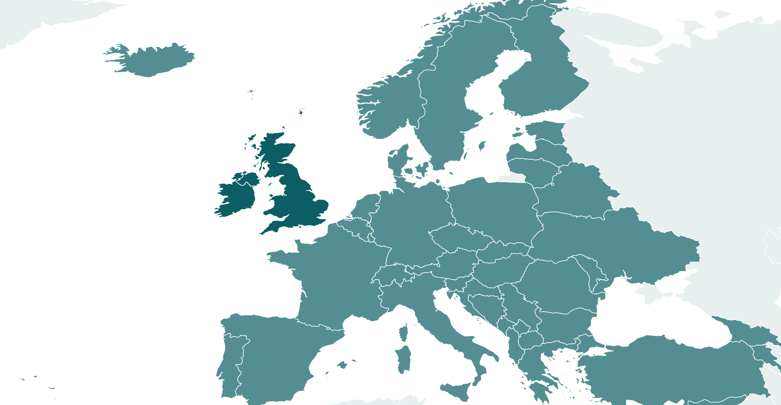
WHO READS · PROJECTED AT SCALE
Who reads Dental Business News
76% own, lead or manage a practice. Projected profile at scale, for planning. Measured figures replace these as the list is profiled.
38%
8.0%
30%
24%
WHERE THEY ARE
Owner or principal
Director or clinical lead
Practice manager
Dentists, nurses and hygienists
MOST COMMON ROLES
Practice owner or principal
34%
Practice manager
28%
Associate dentist
14%
Group operations and finance
6.0%
Dental specialist
6.0%
Treatment coordinator
4.0%
96%
2.0%
2.0%
UK and Ireland
Europe
Rest of world
PRACTICE TYPE
OWNERSHIP
PRACTICE TURNOVER
Fully private
28%
Independent
64%
Under £500k
30%
Mostly private
30%
Small group, 2 to 9
18%
£500k to £1m
34%
Mixed NHS and private
26%
Corporate, 10 or more
18%
£1m to £3m
26%
Mostly NHS
16%
Over £3m
10%
DENTAL BUSINESS NEWS · WHO READS
3 / 7

Slide 4
WHAT YOU CAN BUY
Four ways in.
Every format is digital. Our subscribers have requested to receive content from brands who are able to help their business.
Website banners
Sponsored newsletter content
970×250
300×250
Your brand across the whole site.
Sponsored
Your story in “The Monday Check-Up”, next to our editorial and labelled as sponsored.
HOW A BOOKING RUNS
728×90
01
You tell us what channels you want to use.
970×250 · 728×90 · 300×250
400 words · logo · one link
02
We confirm format, date and price in writing.
03
You send artwork, or copy and we build it.
Newsletter sponsorship
Solus email
04
You approve it before anything goes out.
Sponsor
05
We send the report on your campaign alone.
Your brand as the named sponsor of every issue of The Monday Check-Up.
Your email
Your own email, sent to our subscribers. Nobody else in it.
Banner
Per issue, or sponsor a series
We build it, or send finished HTML
DENTAL BUSINESS NEWS · WHAT YOU CAN BUY
4 / 7

Slide 5
RATES
Build a campaign.
FORMAT
ONE
THREE
SIX
EMAIL
Our team of marketing experts can work with you to build bespoke campaigns to fit your advertising goals and strategies.
All marketing options are built to send our audience straight to your website with one easy click.
Whatever you chose, it’s designed to deliver traffic to you.
Eshot
£2,000
£1,500
£1,000
Your message alone, nobody else in it
EACH
EACH
Newsletter sponsorship
£1,600
£1,200
£800
Named sponsor of The Monday Check-Up
EACH
EACH
CONTENT
Sponsored article
£400
£300
£200
On the website and in the newsletter
EACH
EACH
DISPLAY
ONE MONTH
THREE MONTH
SIX MONTH
Homescreen Pop-Up
£2,400
£5,400
£7,200
Pops up after 6 seconds
TOTAL
TOTAL
Billboard, 970×250
£1,800
£4,200
£6,000
TALK IT THROUGH
Top of the homepage
TOTAL
TOTAL
jb@dentalbusinessnews.com
Leaderboard, 728×90
£1,200
£2,400
£3,600
Across the site
TOTAL
TOTAL
MPU, 300×250
£800
£1,600
£2,400
Sidebar button
TOTAL
TOTAL
All rates exclude VAT
DENTAL BUSINESS NEWS · RATES
5 / 7

Slide 6
WHAT RESULTS YOU GET
The numbers
you get back.
Statistics
All numbers are an average
EMAIL CAMPAIGN
Delivered
Inboxes it actually reached
7,293
Within 7 days of your campaign finishing, you’ll receive a full performance report showing impressions, open rate and click-throughs to your website.
Unique opens
People who opened, counted once
52.9%
Unique clicks
People who clicked, counted once
6.7%
Click to open
Of those who opened, who then clicked
12.7%
Unsubscribes
Off the list after your send
0.04%
ON THE SITE
Monthly Total Visits
Total impressions on your content
14,127
WHEN YOU GET A REPORT
Monthly Unique Visitors
Unique users who saw your content
10,496
Within 7 working days of the send.
DENTAL BUSINESS NEWS · WHAT RESULTS YOU GET
6 / 7
Notes:
Delivered is the current list size. Rates pooled across 7 issues. Visits and unique visitors: GA4 sessions and total users, 2026-09-20 to 2026-10-19.

Slide 7
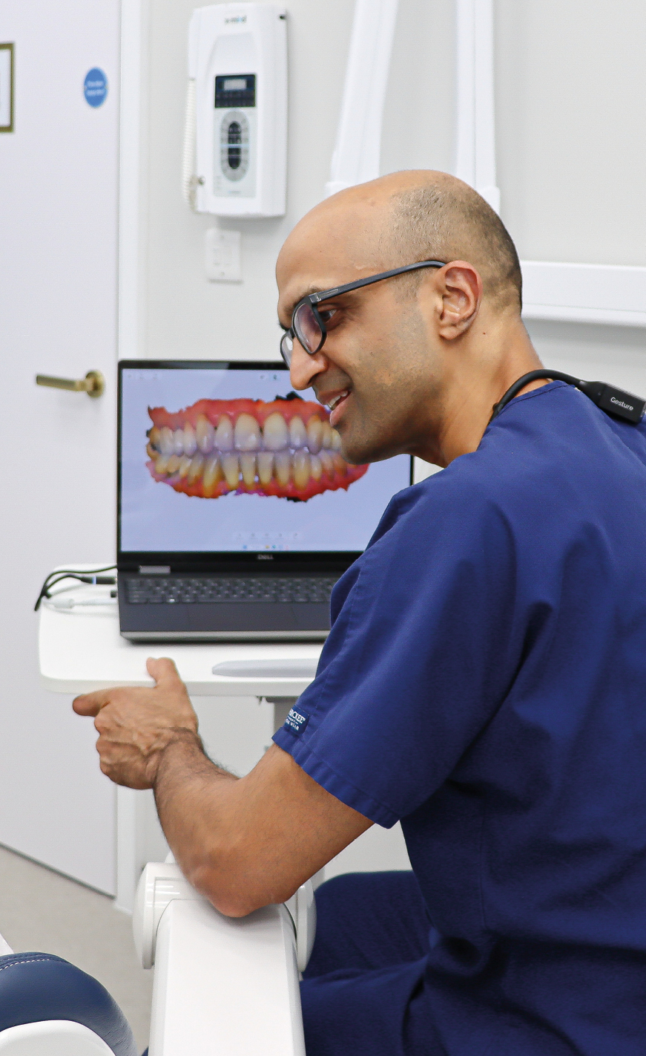
ADVERTISE WITH US
Get in touch.
Tell us who you are trying to reach and what you want it to do, and we will come back with a plan, availability and a price.
ADVERTISING
jb@dentalbusinessnews.com
SEND US A STORY
dentalbusinessnews.com/submit-news
SUBSCRIBE FREE
dentalbusinessnews.com/newsletter
PUBLISHED BY · COGENT MULTIMEDIA LTD, 5 JUBILEE WAY, FAVERSHAM, KENT

